Slide 1


DODGE THE BLOCKS
Vineet Kumar
2101CS83

Slide 2


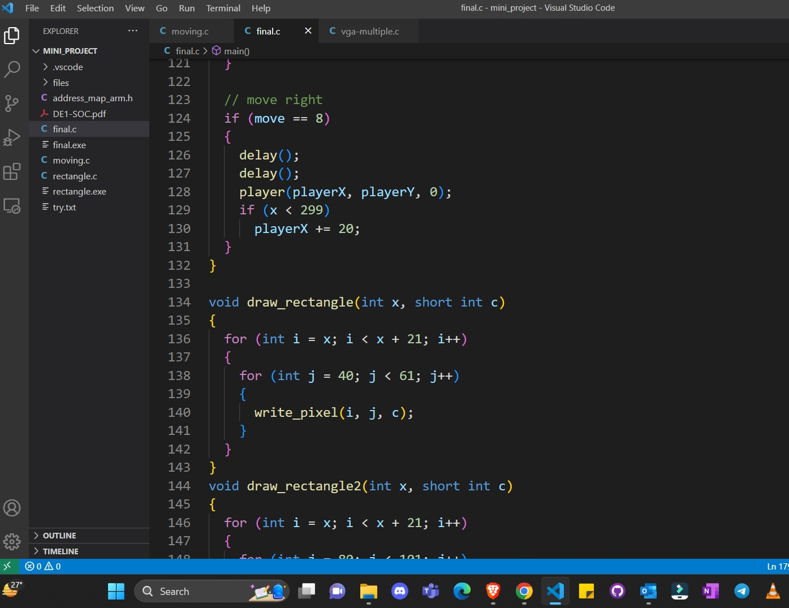
Functions Used
draw_rectangle // to make blocks
player // to draw players
move_player // update player position
delay() // to add delay in program
pushbuttons // to control the player movement

Slide 3
Rectangles and Players
Rectangles – are moving from half of the screen which are in BLUE COLOR
Players – is free to move around the screen which is in GREEN COLOR

Slide 4
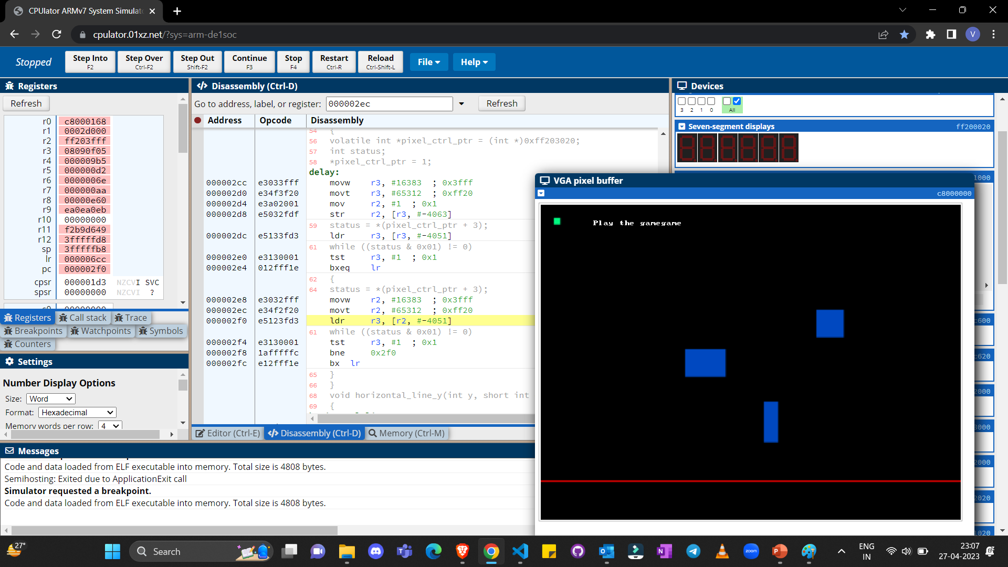
Glimpses of Game

Slide 5
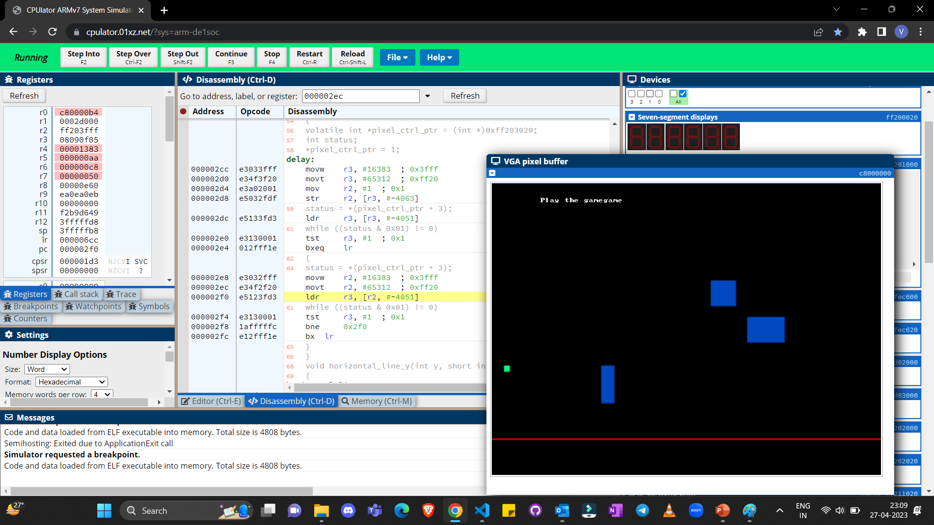
This is between the Game

Slide 6
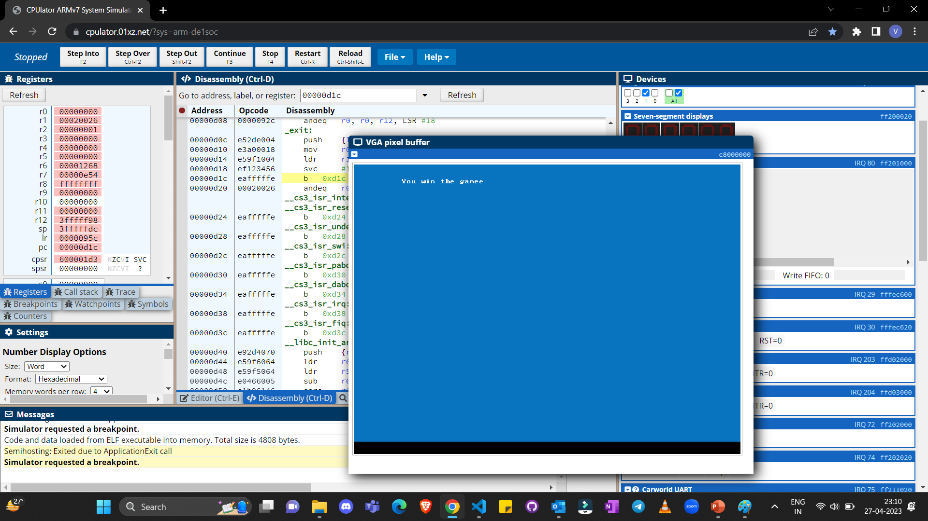
After Crossing the red line

Slide 7
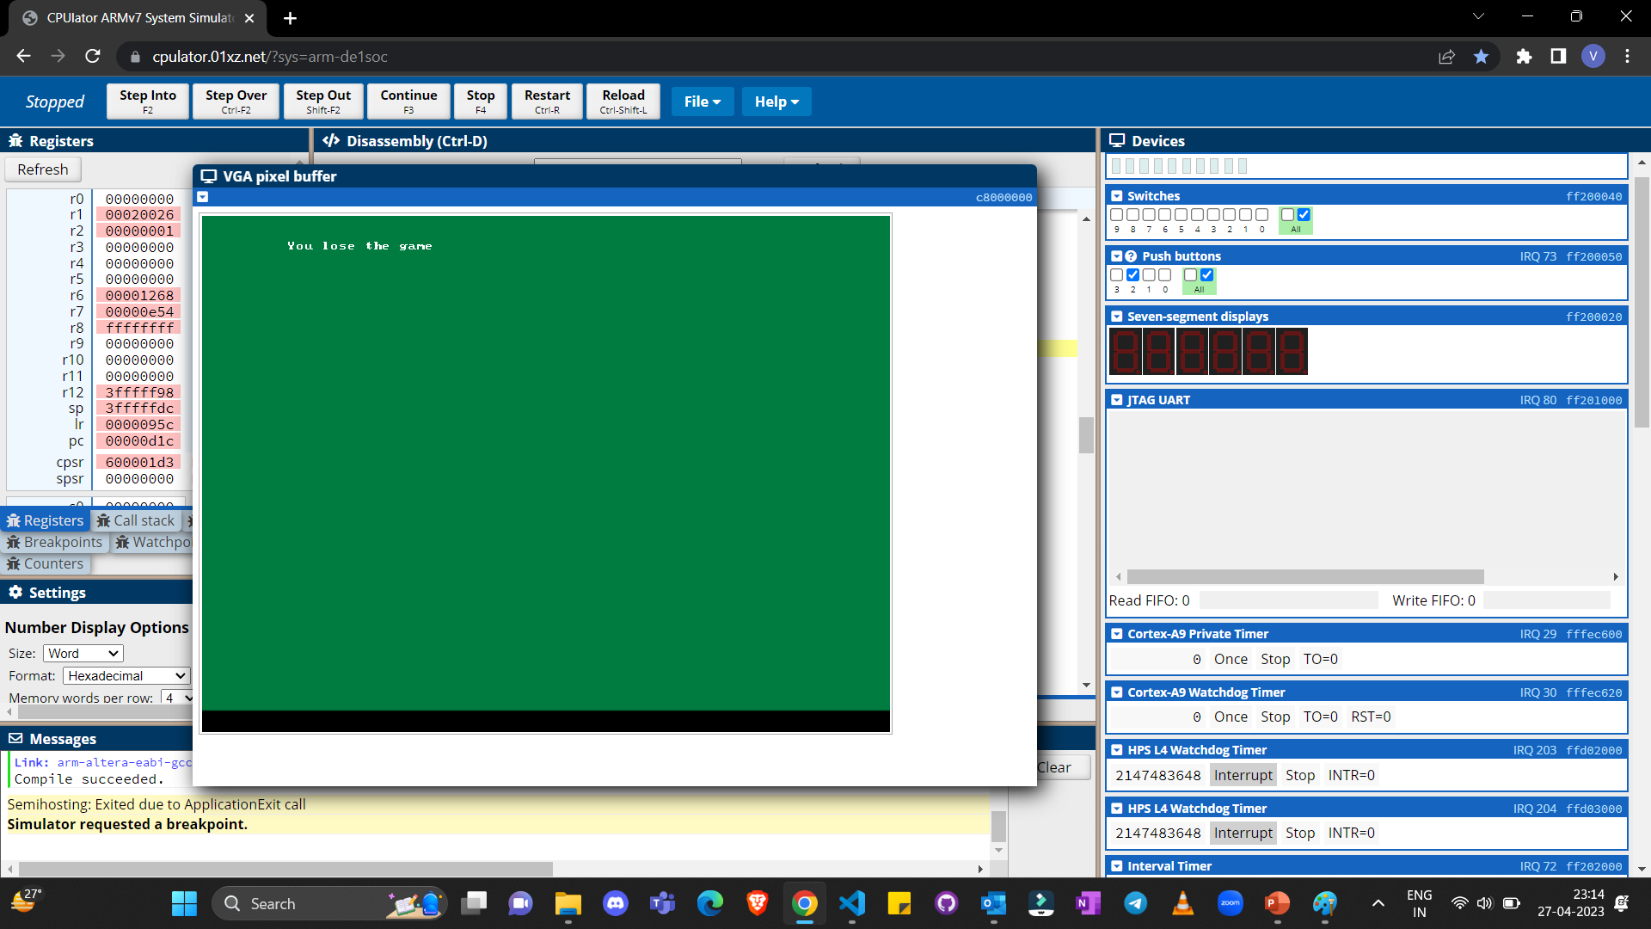
When you hit the block

Slide 8
The use of Button 0xff200050
Button 0 – is used to move the player up
Button 1 – is used to move the player down
Button 2 – is used to move the player left
Button 3 – is used to move the player right, also is used to restart the game after user has win or lose

Slide 9
Colouring and Writing on Pixel
void write_pixel(int x, int y, short int colour)
{
volatile short *vga_addr = (volatile short *)(0xc8000000 + (y << 10) + (x << 1));
*vga_addr = colour;
}
void write_char(int x, int y, char c)
{
// VGA character buffer
volatile char *character_buffer = (char *)(0xc9000000 + (y << 7) + x);
*character_buffer = c;
}

Slide 10
Thank You

